Slide 1
Medical Assistance in Dying: Moving Forward
© Laura Shanner PhD
Vancouver Island University

Slide 2
Overview
Standard caveat: Questions and Headaches
Core Ethical Issues
Supreme Court of Canada’s reasoning
New Legislative Framework
Challenges remaining

Slide 3
Active / Passive Euthanasia
“Active” = killing = commission = to hasten death
“Passive” = letting die = omission = stop delaying death
  Withholding, withdrawing lifesaving intervention
“Terminal sedation”: overdose of painkillers
  Intended to control pain/distress, but dose may suppress breathing

Slide 4
What is the Core Ethical Issue?
  Active / passive distinction usually dominates
    “Okay to let nature take its course but thou shalt not kill”
  Decision to accept death as the appropriate outcome is what matters and needs justification – James Rachels
  mechanism to arrive at death from here is secondary.

Slide 5
Suicide
Almost all suicide attempts involve overwhelming but remediable circumstances
Irrational to choose death when other options exist
  Suicidal ideology is not always proof of incapacity; person may simply see no way out
  Moral imperative to provide medical, psychological, social, economic, practical supports to make living well possible
  24-72 hr “suicide hold” to assess & assist

Slide 6
“Rational suicide”
Some conditions are intractable, unbearable, and will not improve
Logical conclusion: the only option left to relieve unbearable suffering is to die
Ethical principles: beneficence, autonomous choice
Notes:
NOTE: cf Black Lives Matter, police shootings

Slide 7
Supreme court: Rodriguez 1994
Rational suicide possible; Sue Rodriguez is exemplar
  Suicide / attempt not illegal in Canada
Equality, Equal Protection: Unanimous support
  Those physically unable to exercise a legal option have a right to assistance
  Assisted suicide should not be limited to terminal illness
Notes:
Non-terminal cases: NEW in international debate

Slide 8
Supreme court: Rodriguez 1994
However: 5-4 split decision on Rule Utilitarian grounds
  Simply ending prohibition on assisting a suicide, without a framework of protections, would endanger vulnerable persons
  Parliament directed to revise the Criminal Code

Slide 9
Supreme Court: Carter, 2015
New argument: Protection of life and avoidance of premature death
  If someone who may need assistance to commit suicide in the future cannot count on help at that time, then they may choose to end their lives prematurely, while they still can
SCC unanimously reaffirms Rodriguez and accepts equal protection of life argument
Gives Parliament 1 year to revise the Criminal Code
  Election / new government in October, 2015 resulted in 6 month extension

Slide 10
Revised Criminal Code
Bill c-14 – Enacted June 17, 2016
Amendments to Sec. 14, 227, 241 of Criminal Code
  Also Amendments to Pension Act, Corrections and Conditional Release Act, Canadian Forces Members and Veterans Re-establishment and Compensation Act
Sec 14: “No person is entitled to consent to have death inflicted on them…”
  Suicide request must arise from patient, not others
General prohibition on counseling a person to die by suicide or abetting a suicide - Sec 241(1)

Slide 11
Criminal Code Exceptions:
Sec 227, 241
Physicians and Nurse Practitioners may be exempt from culpable homicide for providing medical assistance in dying as per terms of Sec. 241.2
Those who aid the physician or nurse practitioner also exempt (e.g., pharmacist)
Aiding someone to self-administer a substance prescribed by a physician or nurse practitioner is allowable (e.g., family, friend, other health professionals?)
Lawful for social worker, health professional to provide info on legal assisted suicide

Slide 12
Eligibility
Eligible for health services funded by a government in Canada
  No “death tourism”
18 years old and capable of making health care decisions
They have a “grievous and irremediable medical condition”
Voluntary request for assisted dying “that, in particular, was not made as a result of external pressure” and
They give informed consent to receive medical assistance in dying after having been informed of the means that are available to relieve their suffering, including palliative care.

Slide 13
”Grievous and Irremediable”
Sec. 241.2(1)(c), 241.2(2)
they have a serious and incurable illness, disease or disability
they are in an advanced state of irreversible decline in capability
this condition “causes them enduring physical or psychological suffering that is intolerable to them and that cannot be relieved under conditions that they consider acceptable”, and
“their natural death has become reasonably foreseeable … without a prognosis necessarily having been made as to the specific length of time they have remaining.”
Notes:
Clarification needed on 4th point; cf Quebec legislation

Slide 14
Safeguards
Sec 241.2(3)
Person must meet eligibility criteria above
Request made in writing, signed and dated before 2 independent witnesses
  Another person may sign for a patient unable (physically) to sign for themselves
Request made after being informed that the person’s natural death has become reasonably foreseeable
10 day waiting period between signing request and date of assistance, or shorter if physician deems appropriate (loss of capacity or death imminent)
Last-minute opportunity to withdraw the request

Slide 15
Provincial Legal Issues
Licensing, scope of practice for MD, PA, Pharmacy
Access if willing providers unavailable
Insurance, Pensions, Provincial benefits plans
Death certificates

Slide 16
Cases in Canada since legalization
3,714 Total since Quebec’s legislation came into effect (December 10, 2015)
1,523 in the 6 month period July 1 – Dec. 31 2017
1.07% of all deaths in Canada are medically assisted
  International range: 0.3 to 4.0%
Most cases involve cancer (about 65%)
Average age: 73
https://www.canada.ca/en/health-canada/services/publications/health-system-services/medical-assistance-dying-interim-report-june-2018.html

Slide 17
Challenges under review
Terminal diagnosis vs. non-terminal but irremediable
  Canadian Civil Liberties Assn. filed lawsuit days after C-14 passed
Age of consent
Advance directives
Mental health

Slide 18
“Reasonably foreseen” Death
Meaningless phrase: We are all mortal with foreseeable deaths
or
Same as “terminally ill?
  Quebec MAS law: terminal prognosis required
  SCC has twice rejected terminal prognosis as requirement

Slide 19
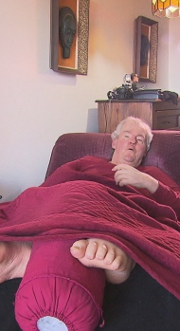
Jean Breault Sherbrooke QC
Died April 7, 2016
Blood clot at brainstem 42 years ago left nearly total paralysis
2011: 2-month hunger strike; MDs threatened transfer to psychiatric ward
Feb. 2016: Applied for MAS, denied b/c not terminal
53 day hunger strike
Offered MAiD when effects of starvation irreversible
CBC News, April 15, 2016

Slide 20
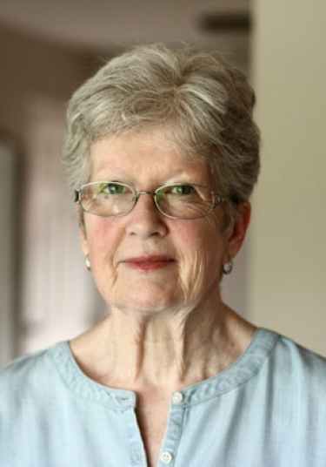
Robyn Moro: Inconsistent Application
68 year old BC woman with Parkinson’s Disease
Physician performs MAiD, but believed Moro had more than 5 years’ life expectancy so refused in her case
Alberta case then approved MAiD for a patient with 10-year life expectancy, so physician changed her mind
Moro died with MAiD on Aug. 31, 2017
Moro remains a named plaintiff in court challenge re: “reasonably foreseeable” death

Slide 21
Age of Consent / Mature Minor
Age of consent varies across provinces
BC Infants Act (Sec. 17): anyone under age 19 can consent to their own medical care if they are capable.
  Child understands need for treatment, what treatment involves, consequences of treatment and non-treatment
  If MD decides that the child understands, and treatment is in the child’s best interests, consent of parent/guardian not required.
  Most common: birth control, abortion, mental health, STDs, addiction. Very young can consent to minor procedures

Slide 22
Advance Directives
Statement of wishes to authorize / refuse medical treatment under various future circumstances if unable to consent at the time
If decision made to refuse lifesaving treatment, why not allow person to request hastened death as well?
May require additional layer of review

Slide 23
Mental Health
Not all mental health diagnoses = incapable of consent
Many severe symptoms are intractable and intolerable
Physical ability to commit suicide is possible for most
  Attempt often fails, leaving person worse off
Additional review, assistance may protect vulnerable, reduce trauma

Slide 24
Larger Context
Easier to let people die than to provide needed medical, psycho-social, economic and practical supports?
  Seniors’ centres, mental health resources, pharmacare
Health system emphasis on crisis care, rescue
  Short on community, outpatient, long-term and home-based care
  1% of GDP in health care for last 6 months of life
Expectations, cultural constructions and barriers re: mortality

Slide 25
Thank you!
These are very difficult issues for policy makers, for health care providers, and especially for individuals and their loved ones.
We have a lot of work still to do.
I hope you have some new resources to continue these conversations as we move forward together, with compassion and support.
Laura.shanner@viu.ca

